Slide 1
1 황성현 15:01-15:03

Slide 2
2 한병현 15:04-15:06

Slide 3
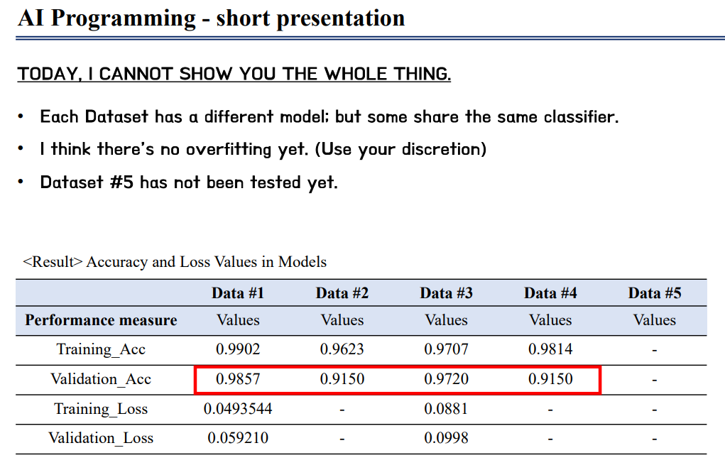
3 한명수 15:07-15:09

Slide 4
Computer vision
VQ-VAE (ex VQ-VAE, VQ-VAE2)
Transformer based model ( ex ViT, Swin Transformer, DeiT)
Self-supervised learning
simCLR, MOCO, BEiT, MAE
CNN
Resnet, Efficient-net
Multi-modal
Transformer based multi-modal (ex ViLT, ALBEF, OSCAR)
Dataset 3
Acc > 97%
pytorch
4 최호영 15:10-15:12

Slide 5
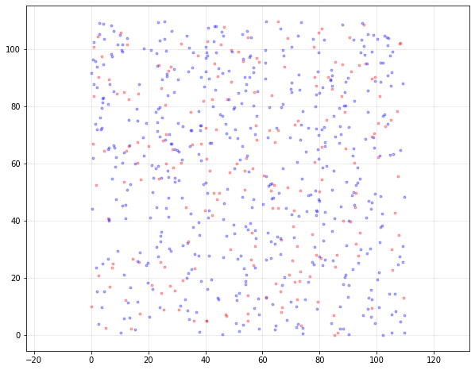
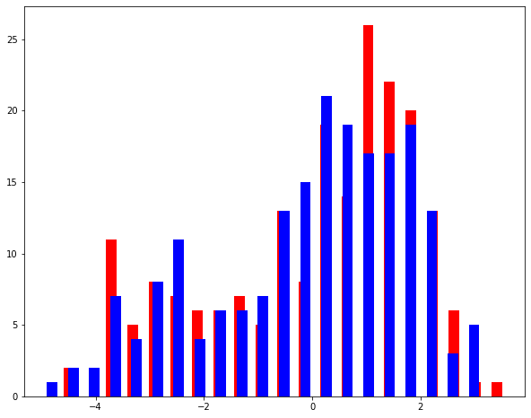
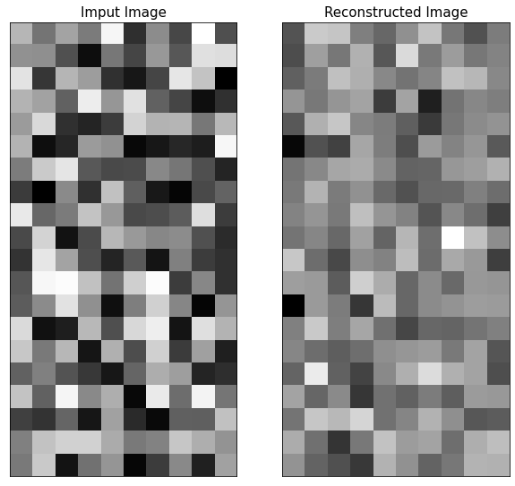

5 최찬역 15:13-15:15
AI
Programming
Preprocessing
Dataset #1
0
1
X1
한양대학교
인공지능융합학과
석사과정
최찬역
X0
1

Slide 6
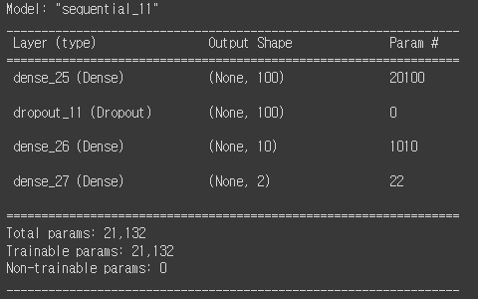
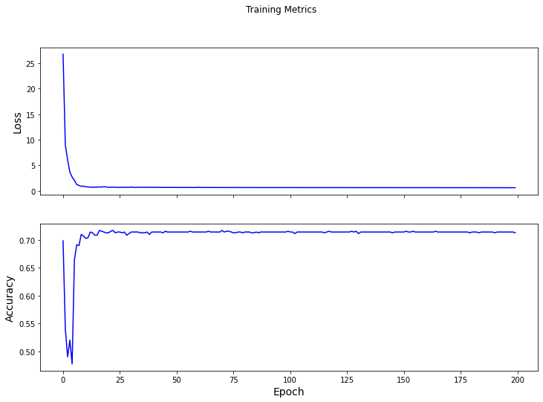
5 최찬역 15:13-15:15
model.evaluate(testdata, testy, verbose=2)
11/11 - 0s - loss: 0.6084 - accuracy: 0.7143 - 147ms/epoch - 13ms/step
[0.6084406971931458, 0.7142857313156128]
2

Slide 7
6 정홍석 15:16-15:18

Slide 8
Project proposal
7 정동호 15:19-15:21
Dataset: dataset3
Train set: 60000 records, 784 features, 10 classes, balanced label ratio
Test set: 60000 records, 784 features, 10 classes, balanced label ratio
Model
Classifier with stratified k-fold cross validation
Multi Layer Perceptron
6 layers with batch normalization
Testset result: 97.5% acc, 97.7% precision, 97.5% recall, 97.5% F1-score
XGBoost
No parameter grid search
Testset result: 97.5% acc, 97.5% precision, 97.5% recall, 97.5% F1-score
To do: parameter search, feature engineering, etc.

Slide 9
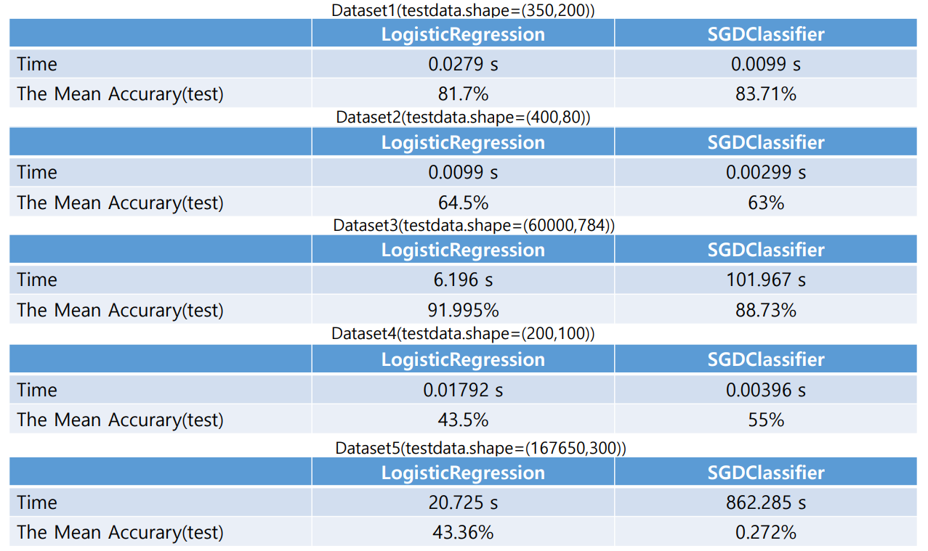
8 장호천 15:22-15:24

Slide 10
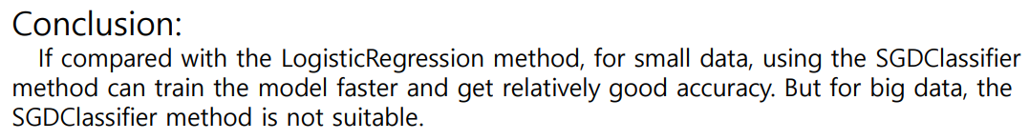
8 장호천 15:22-15:24

Slide 11
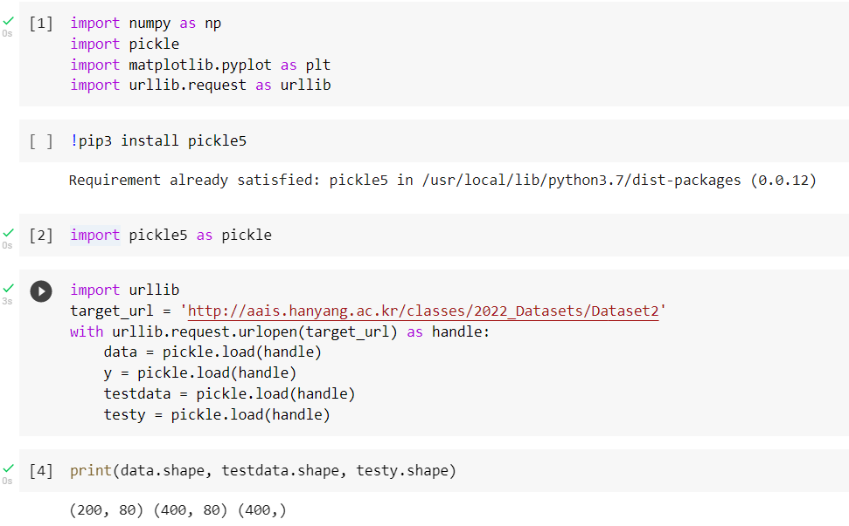
Outline
9 임유석 15:25-15:27
I took the Dataset 2 for classification python programing
testdata for X
testy for y

Slide 12
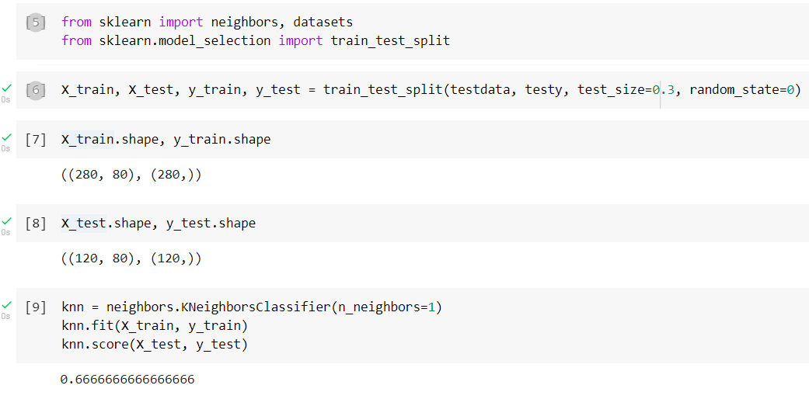
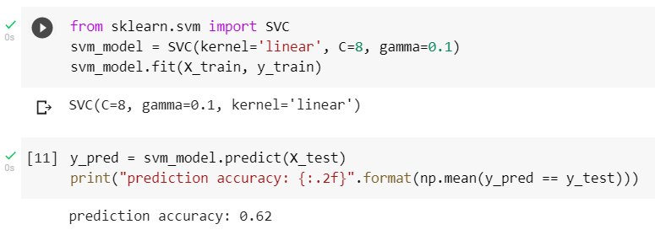
Classification results
9 임유석 15:25-15:27
I would like to compare two kinds of classification algorithm
[ kNNneighbors ]
[ SVM ]
Prediction accuracy : 66.6 %
Prediction accuracy : 62 %

Slide 13
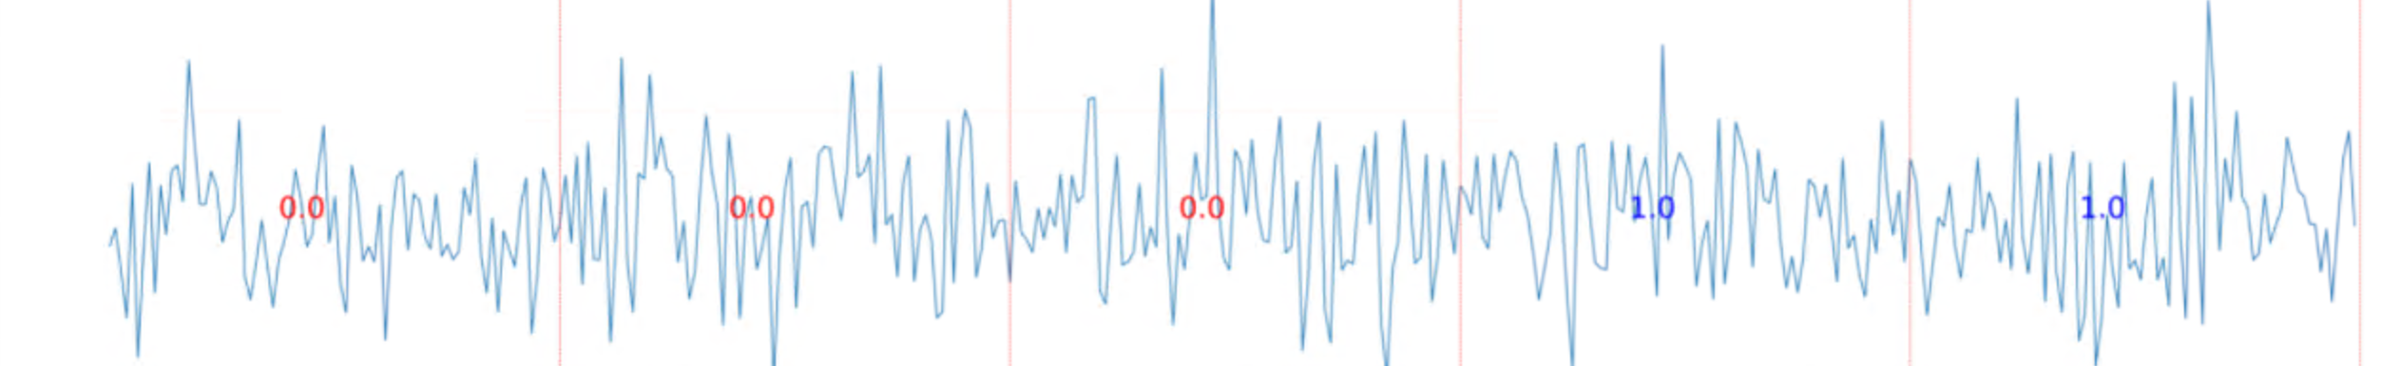
Dataset2 - base line model : Multi-resolution 1d convolution + Attention based model - further plan - Data augmentation - Model Ensemble - Apply SWAG, multi-SWAG, .. To find better solution
AI programming | 2022.04.29. HaRim Lee
10 이하림 15:28-15:30

Slide 14
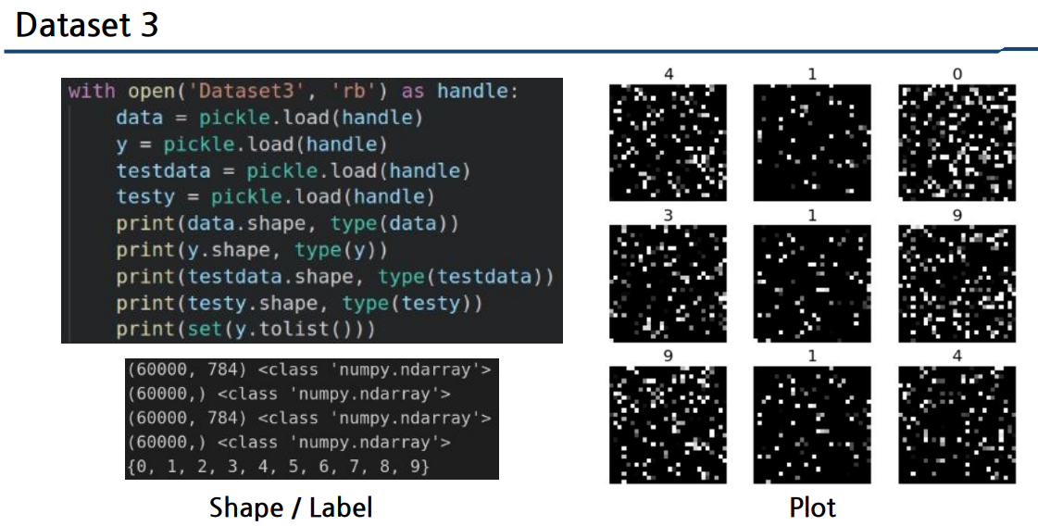
11 이찬우 15:35-15:37

Slide 15
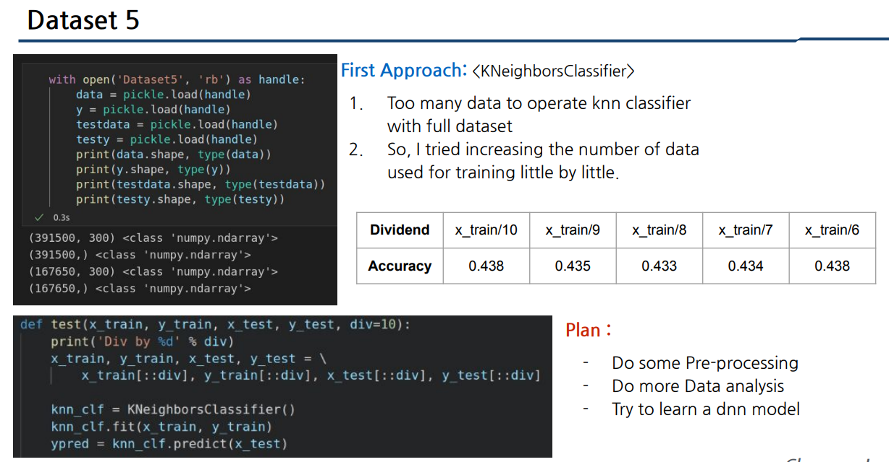
11 이찬우 15:35-15:37

Slide 16
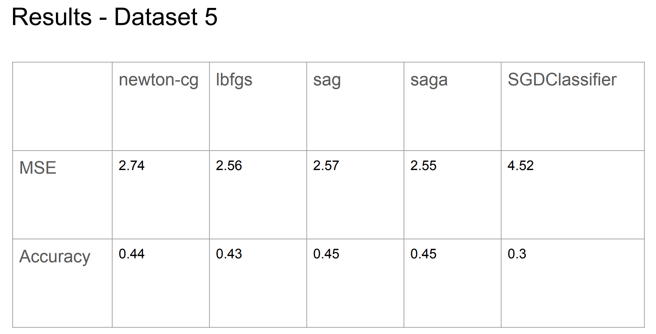
12 이선재 15:38-15:40

Slide 17
13 이동우 15:41-15:43

Slide 18
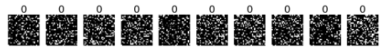
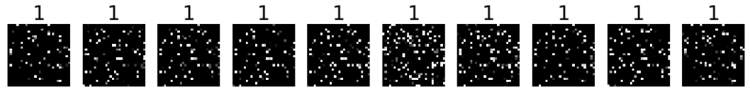
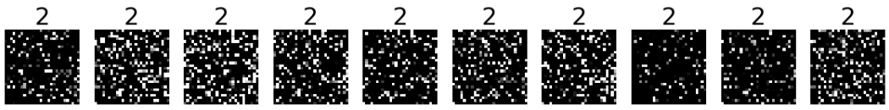
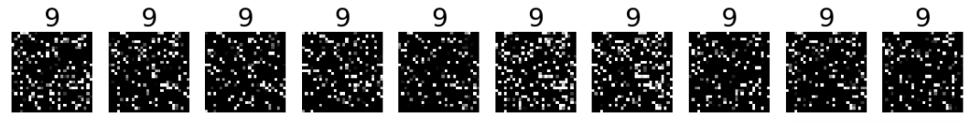
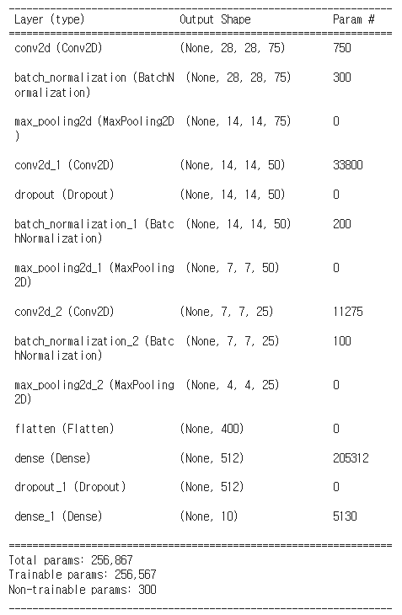
Assignment – Training the specific dataset
14 윤준용 15:44-15:46
Dataset3
x_train, x_test
(60000, 784)
y_train, y_test
(60000, )
min & max value of x
min: 0, max: 255
min & max value of y
min: 0, max: 9
num_categories : 10
…
Make a Model
reshape → 28x28
normalize (divided by 255)
encoding the label → e.g. label 2: [0, 0, 1, 0, 0, 0, 0, 0, 0, 0]
make a CNN model (3 Conv layer, 2 FC layer)
< model.summary >

Slide 19
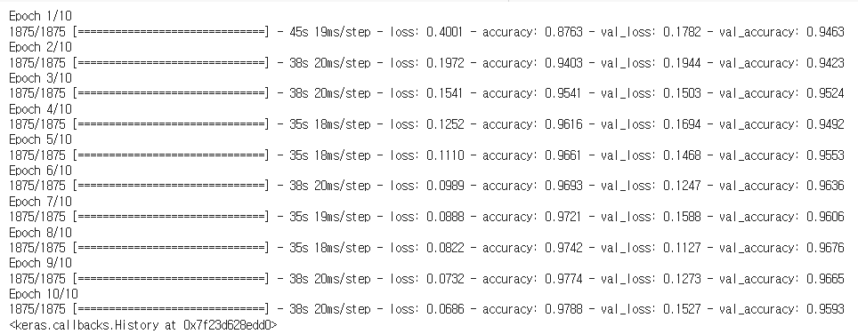
Assignment – Training the specific dataset
14 윤준용 15:44-15:46
Results
epochs: 10
loss: “cross_entropy”
metric: “accuracy” → 0.9593
< results >
Plans
for preventing overfitting
Data Augmentation
Transfer Learning
Analyze the data attribution

Slide 20
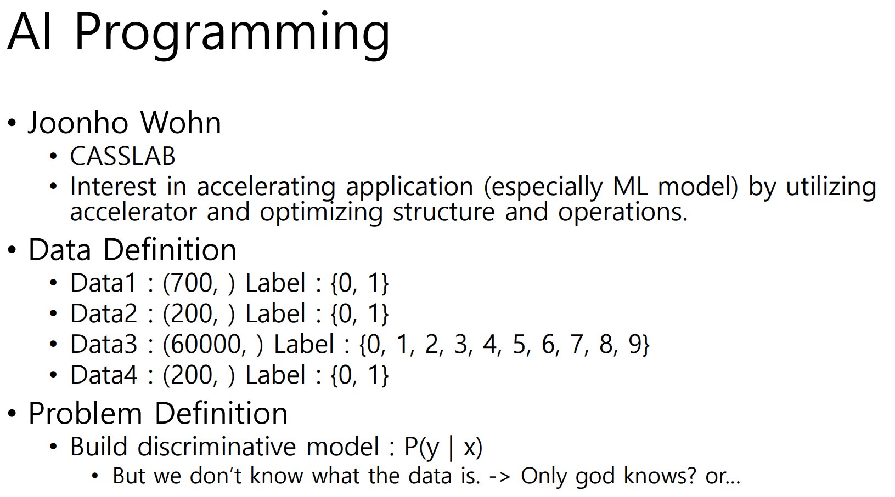
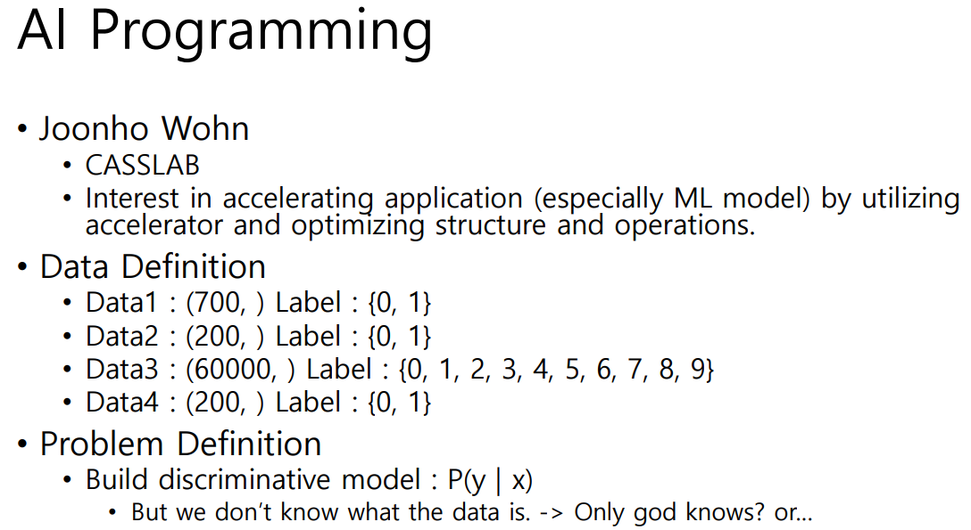
15 원준호 15:47-15:49

Slide 21
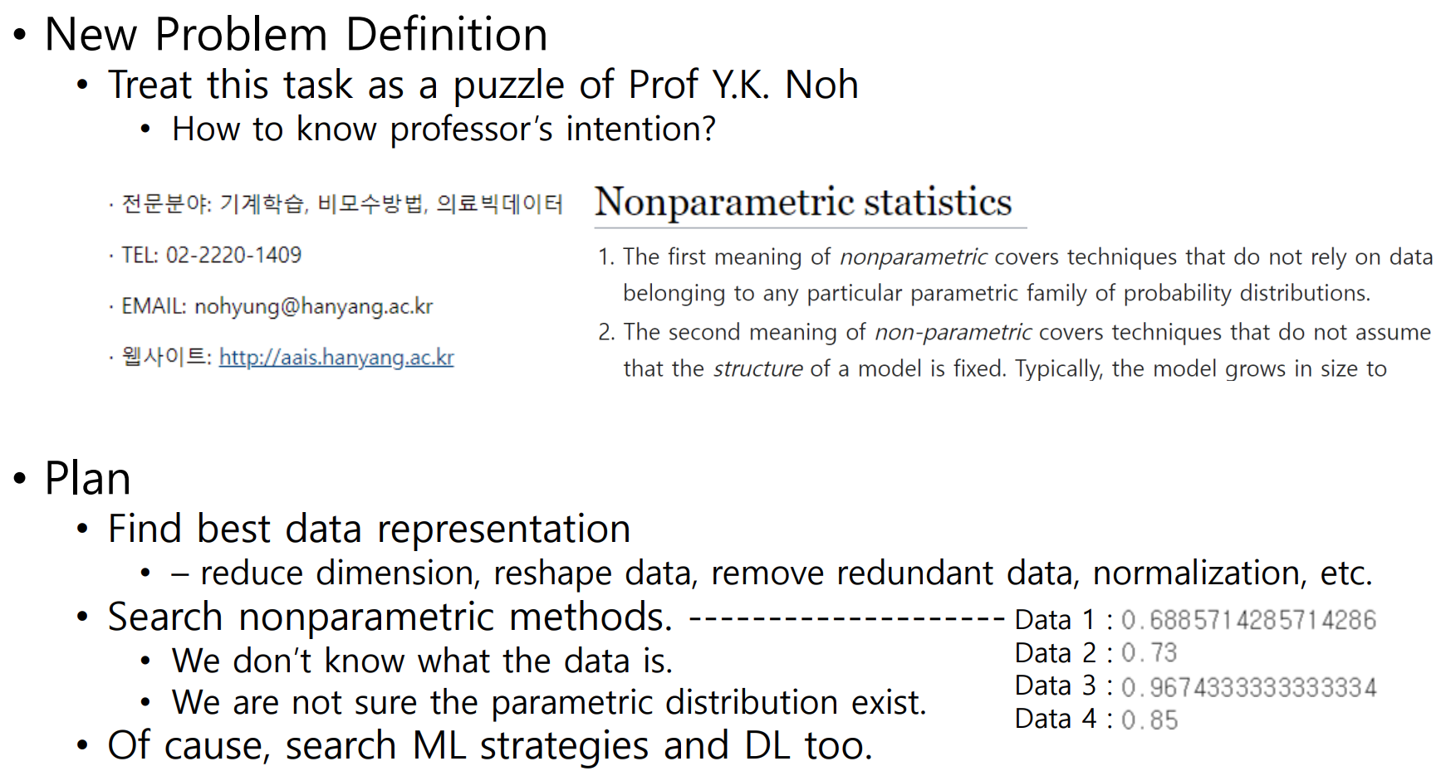
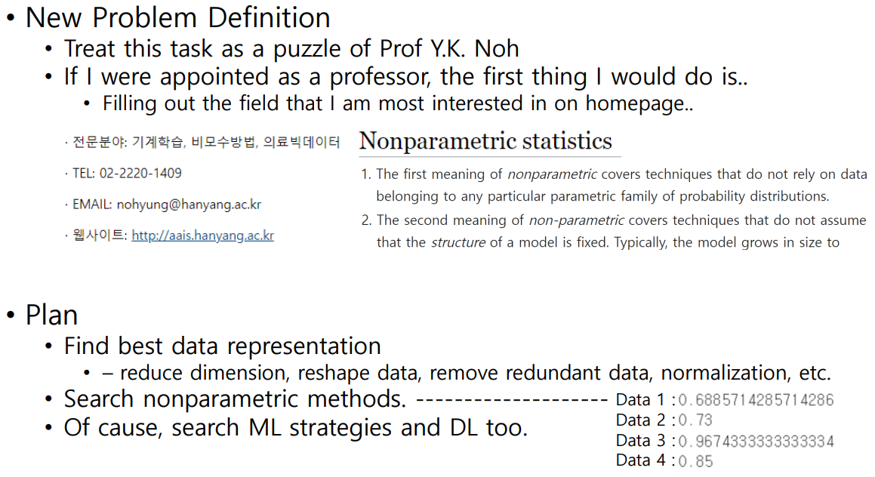
15 원준호 15:47-15:49

Slide 22
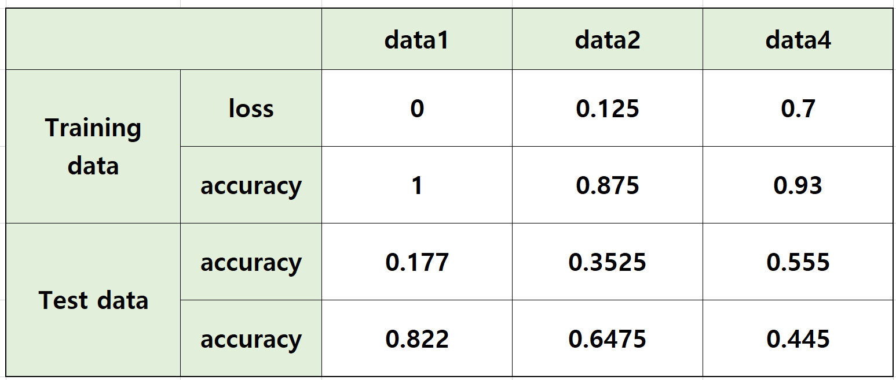
Yuna Oh Department of Articial Intelligence Control and Optimization Laboratory
16 오윤아 15:50-15:52
Plan?
Logistic Regression
Non-linear SVM
Naive Bayes
K-Nearest Neighbors

Slide 23
17 손지원 15:53-15:55
Model Overview
Dense
Layer Norm.
Transformer
Block
Self Attention
Drop out
Layer Norm.
Dense
Dense
Inputs
Drop out
Outputs
Classification
Block
Dense
Drop out
Dense
Dense
Batch Norm.
Average Pooling

Slide 24
17 손지원 15:53-15:55
Experiments
Settings
Dataset3
Training: 80% of ‘data’
Validation: 20% of ‘data’
For early stop (patience=20)
Test: ‘test data’
Preprocessing ‘y’
One-hot encoding
Result
Converged in 39 epochs (63 secs/epoch)
 | Loss | Accuracy
Training | 0.0332 | 98.94%
Validation | 0.0641 | 98.27%
Test | 0.0735 | 97.99%

Slide 25
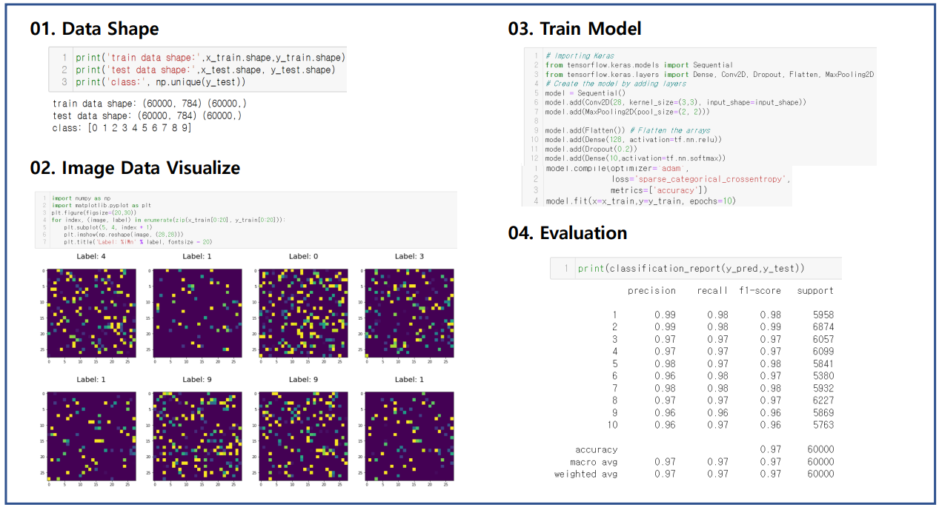
18 성은선 15:56-15:58

Slide 26

19 변준영 15:59-16:01

Slide 27
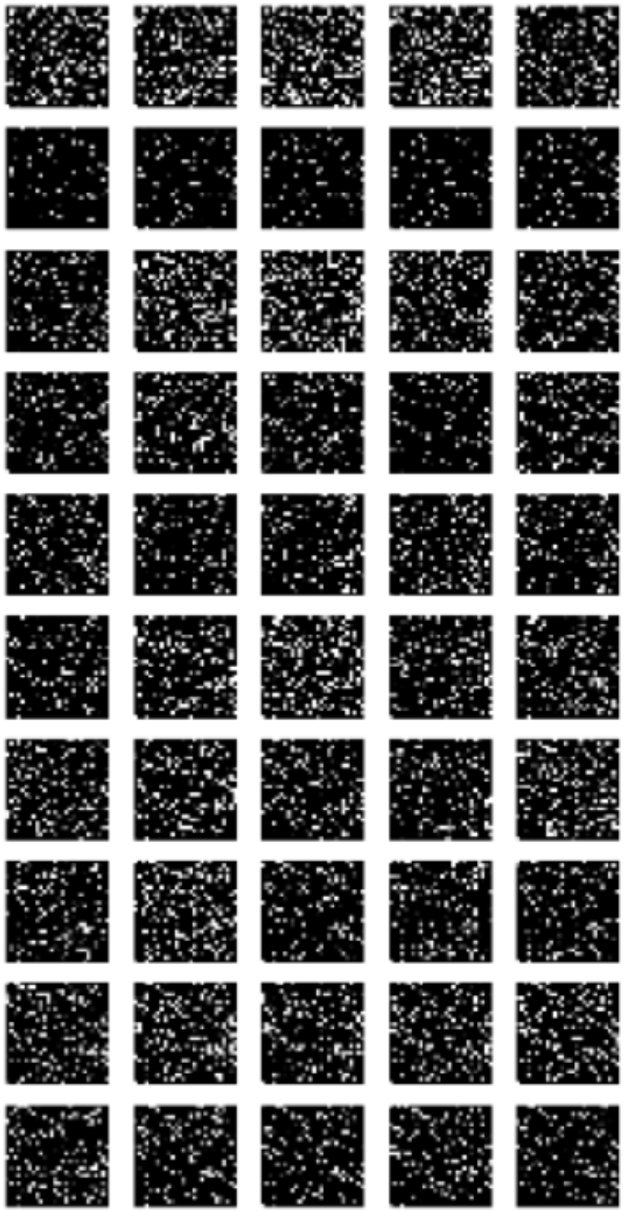

20 배영호 16:11-16:13

Slide 28
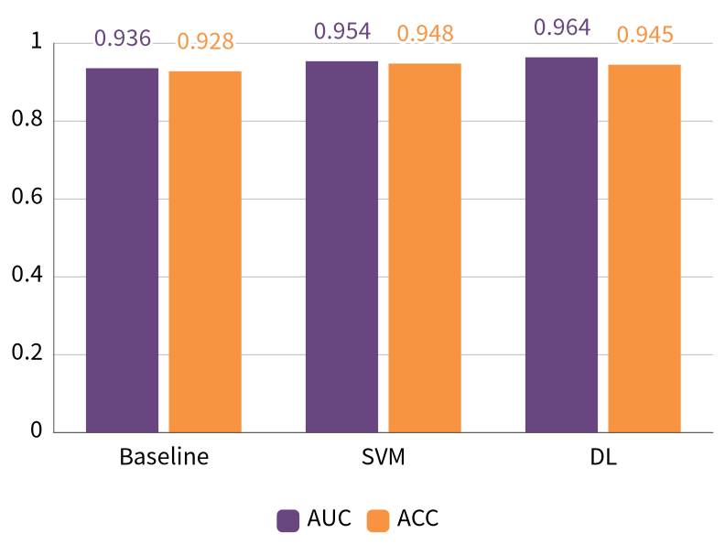
20 배영호 16:11-16:13

Slide 29
21 박성빈 16:14-16:16

Slide 30
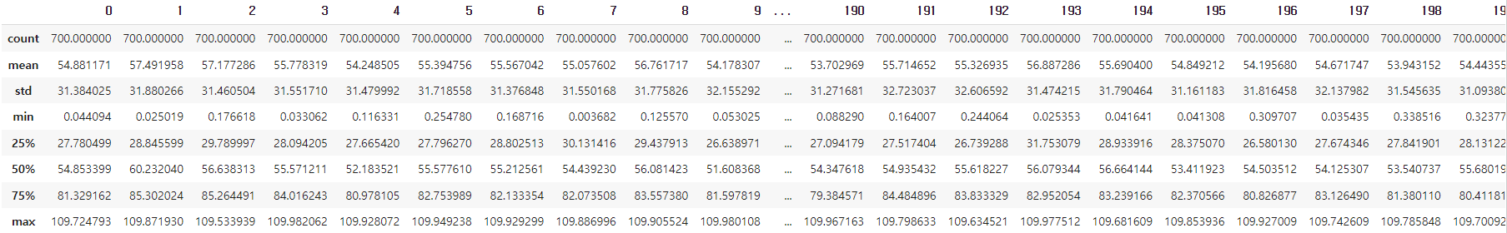
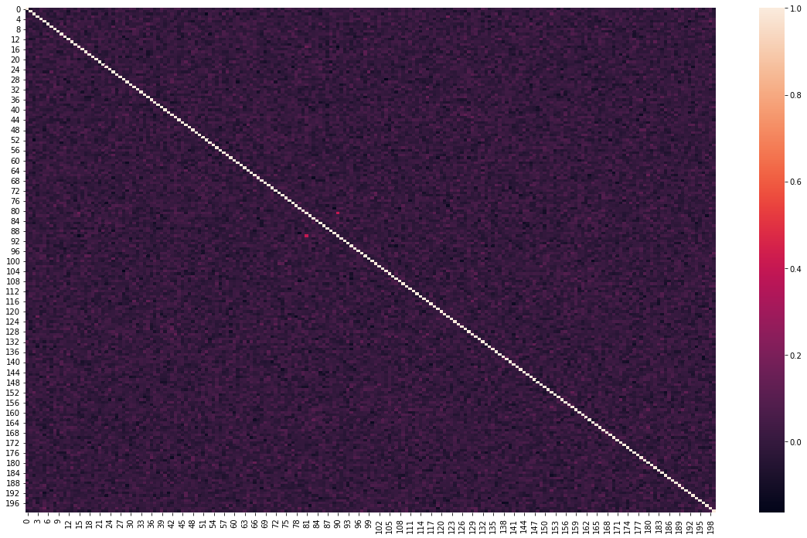
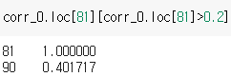
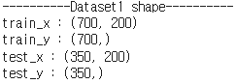
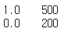
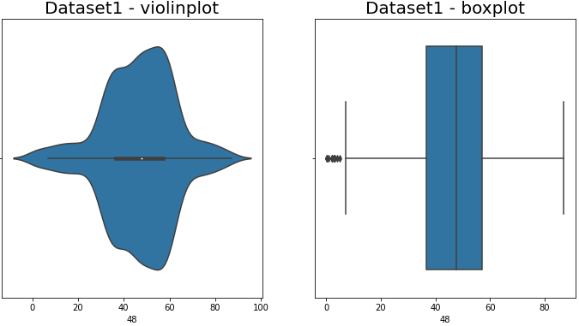
22 박병태 16:17-16:19
Dataset1
# train_x statistic
# Only numerical features
# Spearman correlation
# Nan : X
# Outlier(IQR method)
: only 48th feature > location index - array([8,95,115,117,190,207,282,310,341,347,414,457])
# Target data class count
# Accuracy – test data

Slide 31
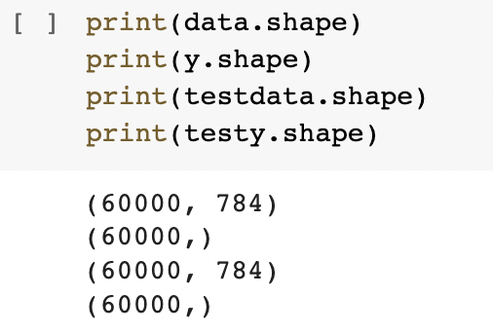
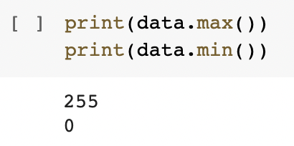
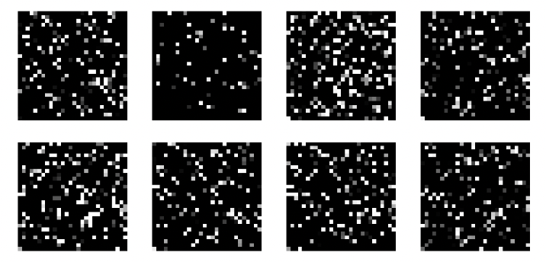
Preliminary Data Analysis
23 루스다((외)) 16:20-16:22
Dataset3
Training Data: 60000 samples x 784 features
Testing Data: 60000 samples x 784 features
Multiclass classification Problem
10 classes {0 to 9}
Image Data
Values in range (0,255)
Approaches
Traditional Machine Learning Algorithms
Classificaiton via Deep Learning

Slide 32
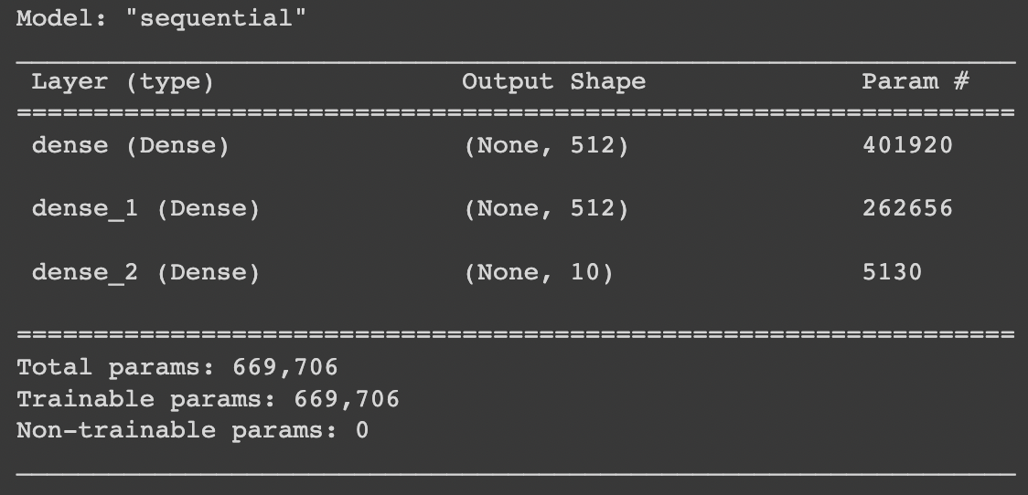
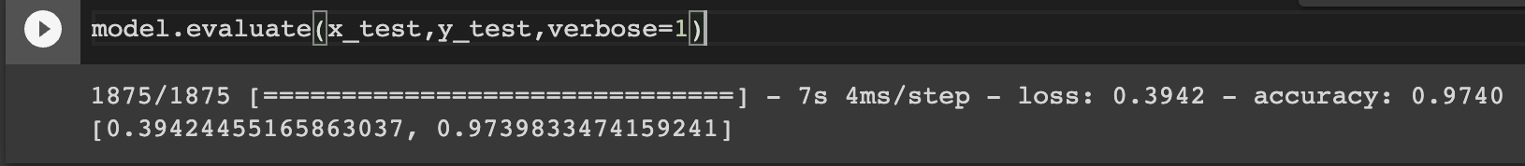
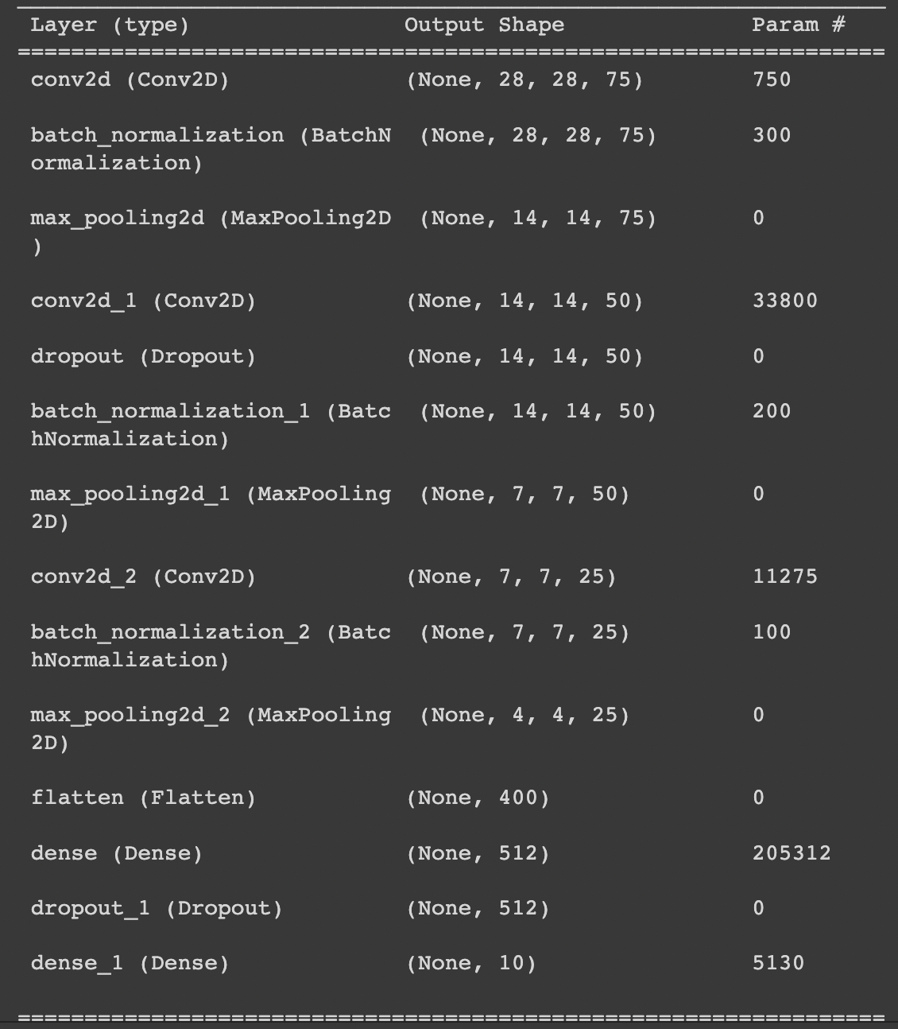
Results
23 루스다((외)) 16:20-16:22
Traditional machine learning algorithms (KNN, Logistic Regression, Decision Trees, Random Forrests, Naïve Bayes)
Failed to provide considerablly accurate results Deep Learning
Simple Neural Network
Normalization
Training (48k samples)
Validation(12k samples)
Testing (60k samples)
Accuracy: 97.39%
CNN
Normalization
Reshaping into 28x28 sized images
Same Training, Validation and Testing data ratio
Accuracy: 96.21%

Slide 33
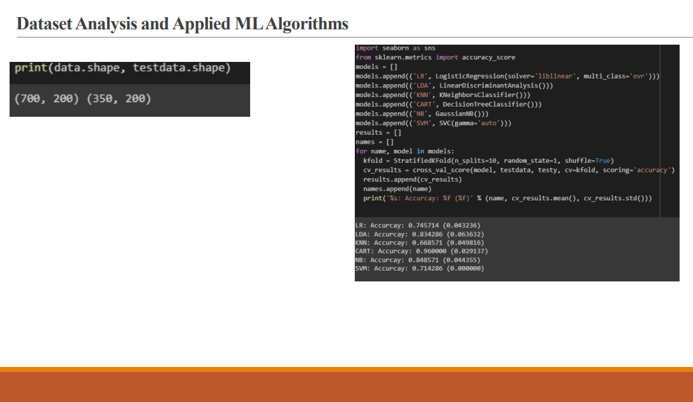
24 라이 안드리16:23-16:25

Slide 34
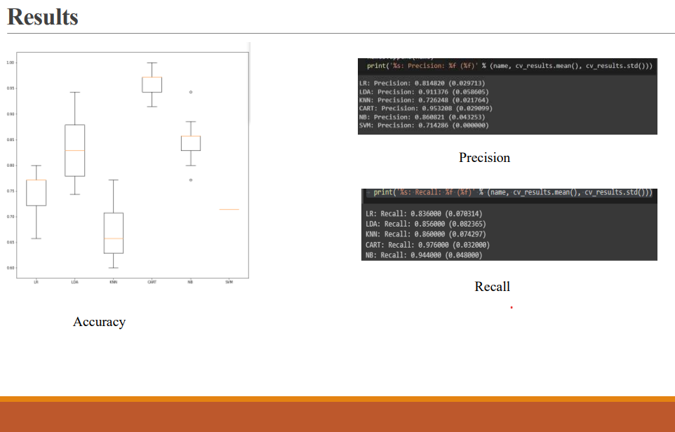
24 라이 안드리16:23-16:25

Slide 35
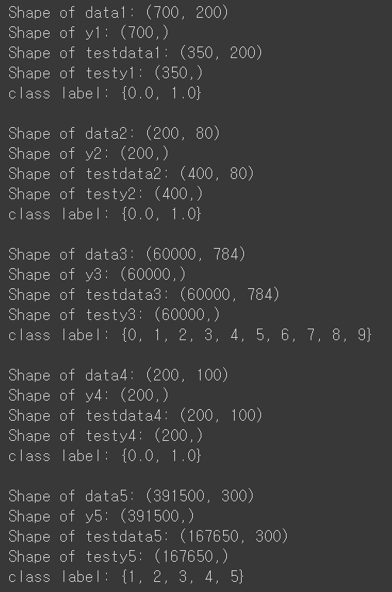
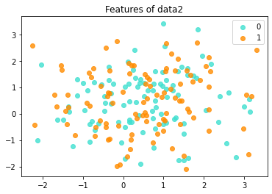
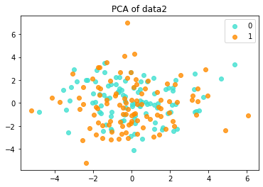
25 남혜린 16:26-16:28
AI programming_Hyerin Nam
Data information
Class | Dataset | 0 | 1 | 2 | 3 | 4 | 5 | 6 | 7 | 8 | 9
1 | 200 | 500
2 | 100 | 100
3 | 5923 | 6742 | 5958 | 6131 | 5842 | 5421 | 5918 | 6265 | 5851 | 5949
4 | 100 | 100
5 |  | 60450 | 78700 | 79400 | 82300 | 90650
N_features = 2
N_PCs = 2
 | 0 | 1
0 | 104 | 96
1 | 98 | 102
ACC | 0.515
 | 0 | 1
0 | 113 | 87
1 | 88 | 112
ACC | 0.563
Results of Logistic Regression using 5 features and 5 principal components respectively

Slide 36
26 김현우 16:29-16:31

Slide 37
AI_Programming
27 김태훈 16:41-16:43
kim Taehoon
Data1 | Logistic Regression | DecisionTreeClassifier | RandomForestClassifier | GradientBoostingClassifier | AdaBoostClassifier | XGBClassifier | LGBMClassifier
Accuracy | 0.8628 | 0.8657 | 0.9228 | 0.9514 | 0.9314 | 0.9428 | 0.9514
MSE | 0.1371 | 0.13429 | 0.0771 | 0.0485 | 0.0685 | 0.0571 | 0.0485
Data2 | Logistic Regression | DecisionTreeClassifier | RandomForestClassifier | GradientBoostingClassifier | AdaBoostClassifier | XGBClassifier | KNN | DNN | CNN | RNN
Accuracy | 0.69 | 0.515 | 0.69 | 0.615 | 0.61 | 0.655 | 0.805 | 0.715 | 0.7250 | 0.5550
MSE | 0.31 | 0.485 | 0.31 | 0.385 | 0.39 | 0.345

Slide 38
28 김진수 16:44-16:46
Progress so far…
Dataset Number | Test Accuracy
1 | 0.9857
2 | 0.7225
3 | 0.9811
4 | 0.985
5 | 0.5863
To Do List
1. Find appropriate model for dataset2 and dataset5.
2. Do some hyperparameter optimization on dataset1 ,3 and 4.
3. Any method not provided above is fine, if the test accuracy can be improved! (In legitimate way…)

Slide 39
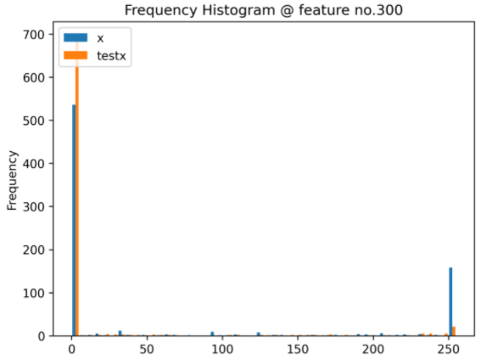
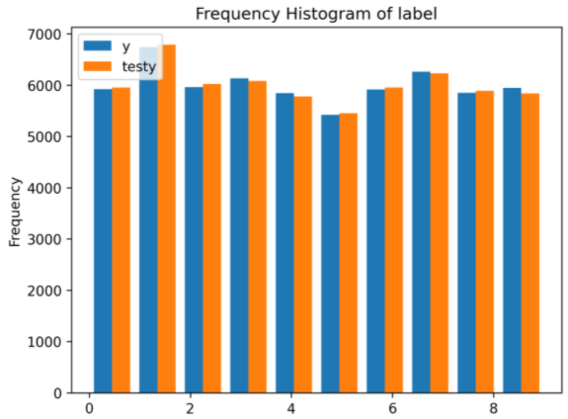
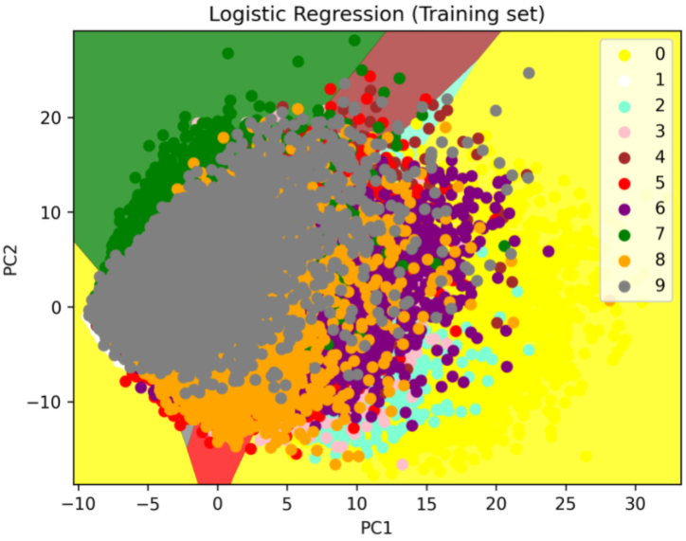
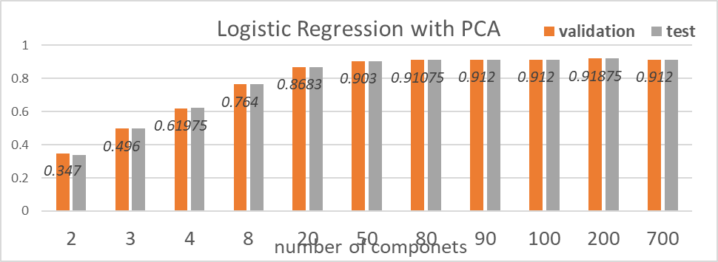

Dataset3
Jihee Kim
29 김지희 16:47-16:49
1. Data Analysis
Balanced Data
- Shape of data: train=test=(60000, 784)
- Label y range: [0, 9]
Fig.1. Histogram of raw data and label (both train and test)
2. Model
Logistic Regression w/ PCA_2 components
Logistic Regression w/ PCA_80 components
SVM
CNN (30epochs,
[conv-BN-pooling]*2-dense-dense)
Fig.2. Visualization of 2-dim data
Fig.3. Logistic Regression result
3. Conclusion
acc | (1) Reg2 | (2) Reg80 | (3) SVM | (4) CNN
Val | 0.347 | 0.911 | 0.986 | 0.967
Test | 0.339 | 0.912 | 0.982 | 0.97
Table.1. Accuracy summary
Fig.4. CNN result

Slide 40
30 김재민 16:50-16:52

Slide 41

31 김은지 16:53-16:55
31) 인공지능학과 김은지
Dataset #1
Dataset #3
Data: Numeric (700, 200)
Label: Binary [0,1] (350, 200)
Data: Image 28x28 (60000, 784)
Label: Multiple (0~9) (60000, 784)
Methodology:
> Data normalization
> Data Standardization
> Random Forest
Accuracy: 0.9229
Methodology:
> Data normalization (/255)
> Reshape (784 -> 28x28)
> Convolution model
Accuracy: 0.9654

Slide 42
32 김성은 16:56-16:58

Slide 43
33 김남형 16:59-17:01

Slide 44










Know your data!
34 김건일 17:11-17:13
distribution
N
D
y
Data
of Data
Dataset1
700
200
0, 1
0
–
110
-
4
–
5
Dataset
2
200
80
0, 1
center: 0.5
0
–
255
Image?
Dataset
3
6x10
784
0
4
–
9
most:
0,
255
Each feature has
similar distribution
with others
-
45
–
45
Dataset
4
200
100
0, 1
center: 0
Dataset
5
4x10
300
1
Image?
–
5
0
5
–
255
Geonil Kim

Slide 45

35 김강산 17:14-17:16

Slide 46
36 구승연 17:17-17:19
train set과 test set 병합, train : validation : test = 8 : 1 : 1
Augmentation 수행 (Dataset size x2)
Lr scheduling
 | TRAIN |  | TEST |  | Test acc.
 | shape | distribution | shape | distribution | After augment
dataset1 | (700, 200) (700,) | 0 : 200 28.6% 1 : 500 71.4% | (350, 200) (350,) | 0 : 100 28.6% 1 : 250 71.4% | [[56 5] [1 139]] 97.01% (N=201)
dataset2 | (200, 80) (200,) | 0 : 100 50.0% 1 : 100 50.0% | (400, 80) (400,) | 0 : 200 50.0% 1 : 200 50.0% | [[55 3] [2 59]] 95.80% (N=119)
dataset3 | (60000, 784) (60000,) | 0 : 5923 9.9% 1 : 6742 11.2% 2 : 5958 9.9% 3 : 6131 10.2% 4 : 5842 9.7% 5 : 5421 9.0% 6 : 5918 9.9% 7 : 6265 10.4% 8 : 5851 9.8% 9 : 5949 9.9% | (60000, 784) (60000,) | 0 : 5952 9.9% 1 : 6791 11.3% 2 : 6026 10.0% 3 : 6084 10.1% 4 : 5780 9.6% 5 : 5454 9.1% 6 : 5957 9.9% 7 : 6231 10.4% 8 : 5890 9.8% 9 : 5835 9.7% | [[ 0 0 0 0 0 0 0 0 0 0 0 0] [ 0 0 0 0 0 0 0 0 0 0 0 0] [ 0 0 2248 1 2 3 1 4 17 3 77 2] [ 0 0 0 2586 34 15 2 6 4 6 46 6] [ 0 0 25 39 1963 21 24 4 32 26 203 5] [ 0 0 7 17 16 2269 1 64 3 12 106 27] [ 0 0 7 4 16 0 2050 3 19 10 60 127] [ 0 0 14 6 5 72 5 1961 17 2 106 42] [ 0 0 11 7 17 0 9 9 2281 0 88 2] [ 0 0 1 10 13 12 12 1 1 2323 55 53] [ 0 0 10 19 17 5 9 16 15 7 2242 32] [ 0 0 9 1 3 21 45 7 1 35 111 2151]] 91.54% (N=24114)
dataset4 | (200, 100) (200,) | 0 : 100 50.0% 1 : 100 50.0% | (200, 100) (200,) | 0 : 100 50.0% 1 : 100 50.0% | [[39 0] [0 43]] 100.00% (N=82)
dataset5 | (391500, 300) (391500,) | 1 : 60450 15.4% 2 : 78700 20.1% 3 : 79400 20.3% 4 : 82300 21.0% 5 : 90650 23.2% | (167650, 300) (167650,) | 1 : 25900 15.4% 2 : 33700 20.1% 3 : 34000 20.3% 4 : 35250 21.0% 5 : 38800 23.1% | [[4038 873 2416 6265 3627] [43 1776 12495 4426 3669] [129 2100 17259 2119 1066] [2736 1068 6316 8875 4462] [222 1993 5345 4782 13330]] 40.63% (N=111430)

Slide 47
Submit Votings for Your Team
Vote five best presenters with whom I want to work.

